Slide 1
Infection Prevention and Control
LTC Advances

Slide 2
Objectives
Review the components of regulation 483.65
Discuss the CMS proposed rule changes for 483.65 and the CMS Infection Control Pilot Project
Describe IC surveillance expectations in LTC
Explain components of an effective antibiotic stewardship program
Identify proven clinical practice tools for recognizing changes in condition
Discuss approaches to improve infection prevention and control practices for the continuum of care in the elderly

Slide 3
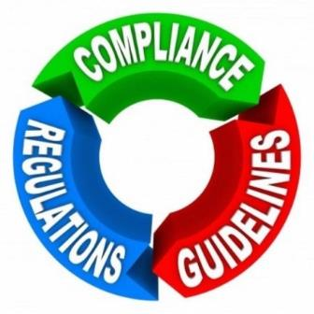
Regulations
1

Slide 4
The Regulation
§483.65 (F441) “The facility must establish and maintain an infection control program designed to provide a safe, sanitary, and comfortable environment and to help prevent the development and transmission of diseases and infection.”

Slide 5
And ……
The facility must establish an infection control program under which it:
Investigates, controls, and prevents infections in the facility;
Decides what procedures, such as isolation should be applied to an individual resident;
Maintains a record of incidents and corrective actions related to infections.

Slide 6
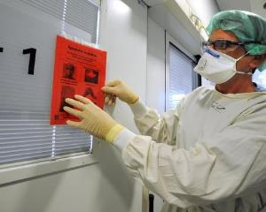
And…
“When the infection control program determines that a resident needs isolation to prevent the spread of infection, the facility must isolate the resident.”
“The facility must prohibit employees with a communicable disease or infected skin lesions from direct contact with residents or their food, if direct contact will transmit the disease.”
Notes:
Mention isolation/transmission based precautions and dietary related concerns with communicable diseases and food borne illnesses.

Slide 7
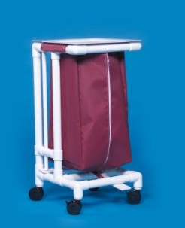
And…
“The facility must require staff to wash their hands after each direct resident contact for which hand washing is indicated by accepted professional practice.”
“Personnel must handle, store, process and transport linens so as to prevent the spread of infection.”
Notes:
This is the final slide describing the regulation. Mention the primary method to prevent the spread of infection being hand hygiene…and that it is everybody’s responsibility. Discuss the management of linens…all soiled linens are considered contaminated and should be treated as infectious…so PPE for sorting and handling all soiled linens.

Slide 8
CMS Proposed Rule and IC Pilot Surveys
2

Slide 9
CMS Proposed Rule

Slide 10
Purpose
“These proposed changes are necessary to reflect the substantial advances that have been made over the past several years in theory and practice of service delivery and safety.
These proposals are also an integral part of our efforts to achieve broad-based improvements both in the quality of health care furnished through federal programs, and in patient safety, while at the same time reducing procedural burdens on providers.”

Slide 11
U. Infection Control
1 – 3 million HAIs in LTC each year
150,000 hospitalizations
388,000 deaths
$673 million to $2 billion in costs
LTC residents have increased susceptibility to infection
Most common HAIs – UTI, Lower Resp. tract, Skin/soft tissue and Gastrointestinal

Slide 12
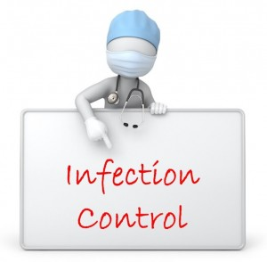
Recommendations
Importance of IPC surveillance
Systems to prevent, identify, report, investigate and control infections
Antibiotic stewardship program
IP with specialized training
Periodic (annual) program review
Integration with QAPI

Slide 13
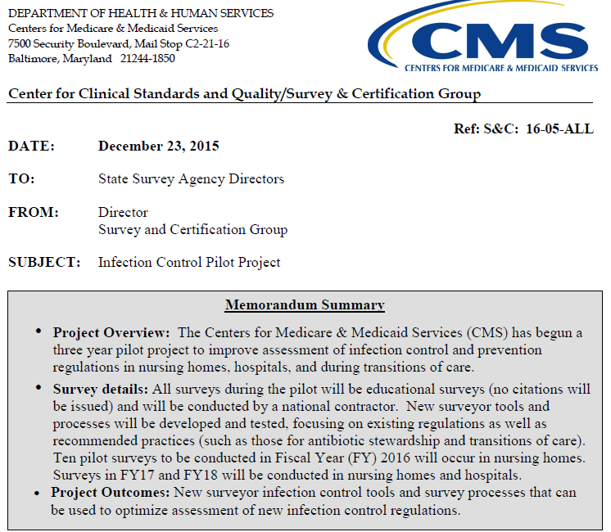

Slide 14
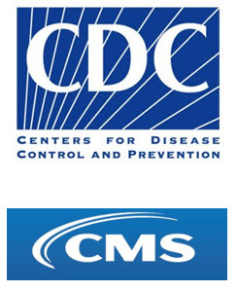
IC Pilot Details
Joint priorities of Center for Disease Control and Centers for Medicare & Medicaid Services
Statistics similar to proposed rule
Importance of core infection control practices
Transitions in care between LTC and acute
Improve surveyor infection control tools and survey processes to optimize infection control

Slide 15
Pilot Project Snapshot
10 in ‘16
National contractor
Educational
Recommended practices
‘17 & ‘18
LTC & acute care
New survey tools
Existing regulations
HAI control
Education
NHSN

Slide 16
Sharing…
Center self-assessment
IP self-assessment
IP advanced training
Annual center IPC risk assessment
Process surveillance
QAPI
Observations – multi-departmental
Staff knowledge
Adherence to standard precautions
PPE use and hand hygiene
Injections – “one needle/one syringe/one time”
Antibiotic stewardship program
Communication with other healthcare providers

Slide 17
Surveillance
3

Slide 18
Surveillance Review
Ongoing systematic collection, analysis, and interpretation of outcome specific data for use in planning, implementation, and evaluation of infection prevention and control practices.
Process Surveillance – Direct observation of skills, practices and techniques related to infection prevention and control practice
Outcome Surveillance – Collection, documentation and review of data for individual infection cases including comparison of the data to standard written definitions of infections

Slide 19
Outcome Surveillance Practices
For Surveillance only; highly specific
Applied retrospectively; standardized
Focus on transmissible & preventable infections
Data collection, documentation, rates, trends, analysis, communication, action plans, training, follow-up, revision

Slide 20
Process to Outcome Surveillance
Hand hygiene, use of PPE
Medication Pass, injection practices
Wound/skin care
Environmental surfaces
Food service
Isolation practices
Cleaning/disinfecting equipment
Linen handling
Housekeeping techniques

Slide 21
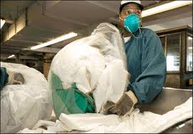
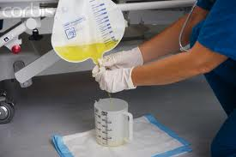
Direct Observations

Slide 22
Control LTC Outbreaks
Outbreak – occurrence of more cases of an illness/disease than expected in a given area during a specified time period.
Most likely outbreaks in LTC
Respiratory infections
Gastrointestinal infection
Skin infestations

Slide 23
Outbreak Management
Consult
Confirm
Contain

Slide 24
Communicable Diseases
Surveillance system for communicable diseases
Reporting requirements
Employee communicable illnesses
Standard and transmission based precautions
Staff education

Slide 25
Antibiotic Stewardship Program
4

Slide 26
Why?
National priority
Frequently prescribed
Prescribed incorrectly
Adverse events
Quality of care
CMS proposed rule
Multiple Drug Resistant Organisms

Slide 27
Antibiotic Stewardship
Antibiotic stewardship refers to a set of commitments and activities designed to “optimize the treatment of infections while reducing the adverse events associated with antibiotic use.” CDC core elements of antibiotic stewardship for nursing homes

Slide 28
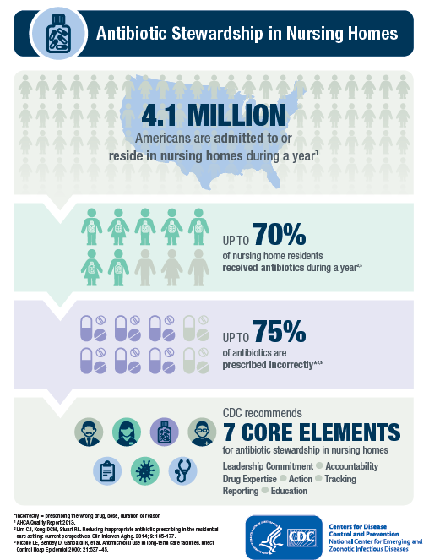

Slide 29
Core Elements of ABS
Leadership commitment
Accountability
Drug expertise
Action
Tracking
Reporting
Education

Slide 30
Leadership Commitment
Write statements
Include stewardship – related duties
Communicate
Create a culture

Slide 31
Accountability
Empower
Medical director
Director of nursing
Infection preventionist
Engage
Consultant pharmacist
Professional partners

Slide 32
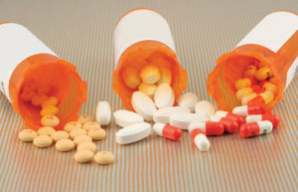
Drug Expertise
Establish access to individuals with antibiotic expertise to implement antibiotic stewardship activities.
Consultant pharmacist
Acute care antibiotic stewardship coordinator/leader
Acute care IP
Notes:
Has the consultant pharmacist been trained in antibiotic stewardship?
Partner with stewardship teams at referral hospitals regarding antibiotic usage and resistant patterns.
Consult with external infectious disease experts.

Slide 33
Actions
ABT orders require dose, duration, indication, & treatment site
Follow change of condition algorithms & communication tools
Follow algorithms for appropriate diagnostic testing
“Antibiotic Time Outs”
Follow treatment recommendations for infections
Review antibiotic agents available in the center

Slide 34
Actions
Consultant Pharmacist involvement
Review antibiotic courses for appropriateness of administration and indication
Establish standards for laboratory monitoring for adverse drug events
Review microbiology culture data to assess and guide antibiotic selection

Slide 35
Tracking
Track how and why antibiotics are prescribed
Track how often and how many antibiotics are prescribed
Track adverse outcomes and costs from antibiotics
Rate of C. Difficile infections
Rates of MDROs

Slide 36
Reporting
Facility specific reports on antibiotic use and outcomes
Review with medical director, consultant pharmacist, clinicians, nursing staff
Review antibiogram patterns
Personalized feedback on antibiotic prescribing practices to clinicians

Slide 37
Education
Education regarding antibiotic stewardship addressing the goals, interventions and responsibility of each of these groups
Clinicians
Nursing staff
Residents
Families

Slide 38
Where to Begin
Checklist for Core Elements
http://www.cdc.gov/longtermcare/pdfs/core-elements-antibiotic-stewardship-checklist.pdf
Education
Nursing staff
Not all “infections” need antibiotics
Care path algorithms

Slide 39
Clinical Practice Tools
5

Slide 40
Care Paths and File Cards

Slide 41
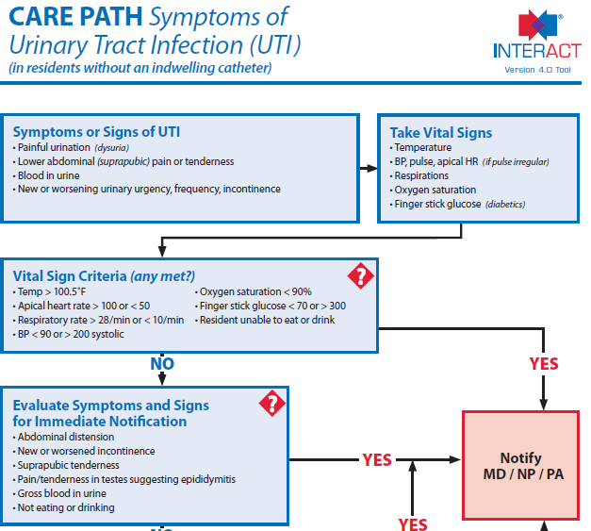
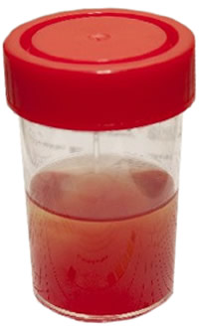

Slide 42
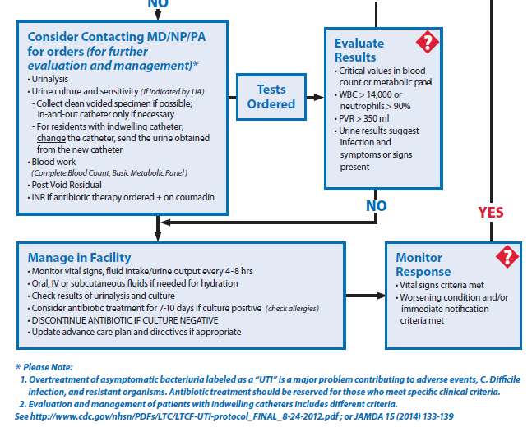

Slide 43
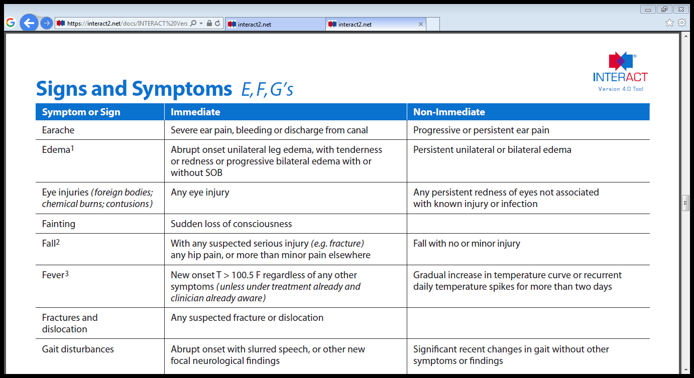
Acute Change of Condition File Cards

Slide 44
Additional Resources

Slide 45
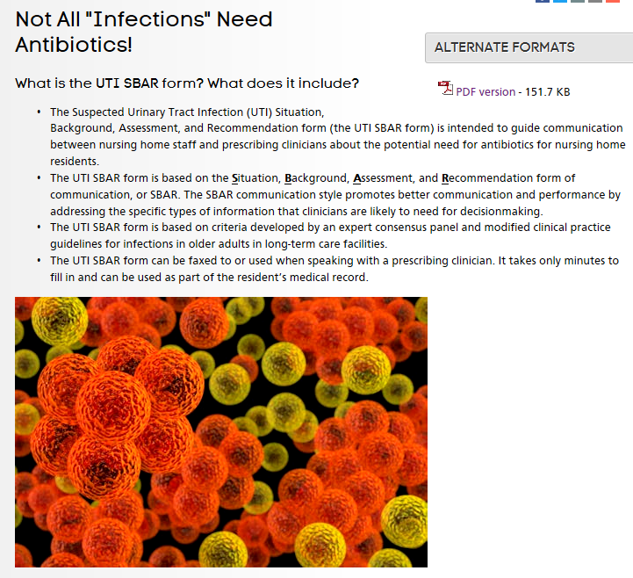
AHRQ Healthcare Associated Infection

Slide 46
UTI SBAR; AHRQ

Slide 47
Background

Slide 48
Assessment and Recommendation

Slide 49
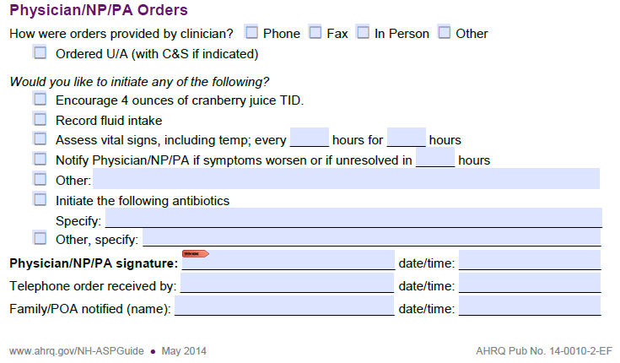
Physician/NP/PA Orders

Slide 50
Transitions to Practice
6

Slide 51
Infection Preventionist
The infection preventionist (IP) is a healthcare professional with specialized training in infection prevention and control beyond his/her initial professional degree.

Slide 52
Role of the IP
Conducts outcome and process surveillance
Identifies trends
Consults on infection risks
Analyzes data
Implements IPC strategies using QAPI membership and processes
Identifies and manages outbreaks
Reports communicable diseases
Follows the guidelines/guidance from CDC, CMS, OSHA & State

Slide 53
Continuum of Care
Standardized definitions
Early recognition of changes in condition
Communication with practitioners
Communication with associated healthcare providers
Education in standards of practice

Slide 54
Summary
Regulations
CMS Proposal
Surveillance
Antibiotic Stewardship
Communicate
Transitions to Practice

Slide 55
Questions? Thank you!
?

Slide 56
References
http://www.ahrq.gov/professionals/quality-patient-safety/patient-safety-resources/resources/nh-aspguide/module1/toolkit1/notallinfections.html
http://www.ahrq.gov/professionals/quality-patient-safety/patient-safety-resources/resources/nh-aspguide/module1/toolkit1/utisbar-form.html
https://interact2.net/
https://www.cms.gov/Medicare/Provider-Enrollment-and-Certification/SurveyCertificationGenInfo/Downloads/Survey-and-Cert-Letter-16-05.pdf
https://www.cms.gov/Medicare/Provider-Enrollment-and-Certification/SurveyCertificationGenInfo/Downloads/Survey-and-Cert-Letter-15-46.pdf
https://www.cms.gov/Regulations-and-Guidance/Guidance/Transmittals/downloads/r55soma.pdf
http://www.cdc.gov/hicpac/pdf/isolation/Isolation2007.pdf
https://wwwn.cdc.gov/nndss/conditions/notifiable/2016/
http://www.cdc.gov/longtermcare/prevention/antibiotic-stewardship.html
Nimalie D. Stone, Muhammad S. Ashraf, Jennifer Calder, Christopher J. Crnich, Kent Crossley, Paul J. Drinka, Carolyn V. Gould, Manisha Juthani-Mehta, Ebbing Lautenbach, Mark Loeb, Taranisia MacCannell, Preeti N. Malani, Lona Mody, Joseph M. Mylotte, Lindsay E. Nicolle, Mary-Claire Roghmann, Steven J. Schweon, Andrew E. Simor, Philip W. Smith, Kurt B. Stevenson and Suzanne F. Bradley (2012). Surveillance Definitions of Infections in Long-Term Care Facilities: Revisiting the McGeer Criteria. Infection Control & Hospital Epidemiology, 33, pp 965-977. doi:10.1086/667743.

