Slide 1
Orchestrating the Arts: A Success Story Supporting Clinical Outcomes

Slide 2
Objectives…
Identify program characteristics to enhance resident engagement
Understand the role of the Arts on clinical outcomes
List the resident, staff and facility benefits of implementing Art programs
Discuss the types of evidenced based Art programs affecting quality of care at The Cedars
Operating for financial sustainability

Slide 3
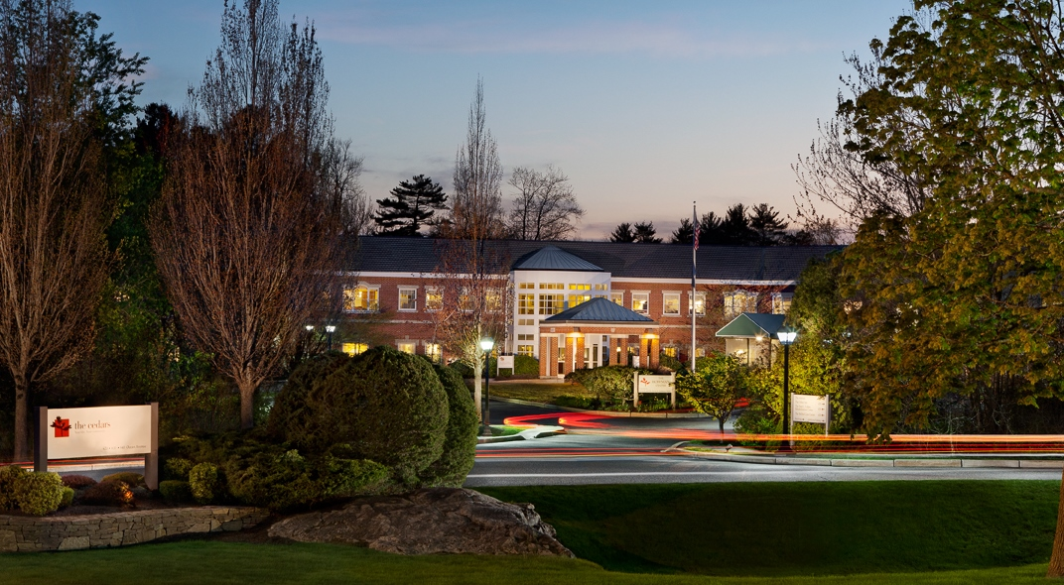
The Cedars: Who We Are…
The Cedars, a non-profit senior living community in Portland since 1929, offers independent living, assisted living, in-patient and out-patient rehabilitation, and skilled care.

Slide 4
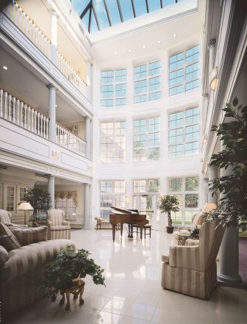
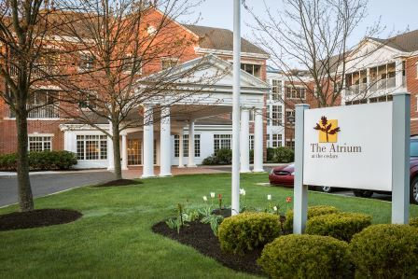
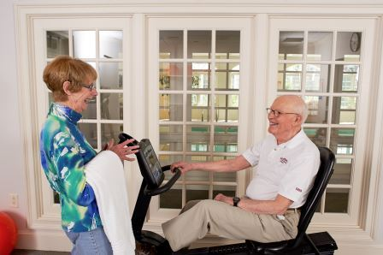
Senior Living Options: The Atrium…
Independent Living at The Atrium
61 spacious apartments
Wellness-focused amenities
Priority access to healthcare services

Slide 5
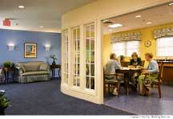
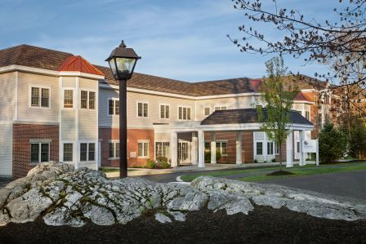
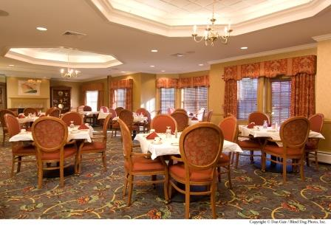
Senior Living Options: The Osher Inn…
Assisted Living at The Osher Inn
30 private apartments
Personalized assisted services
24/7 personal support

Slide 6
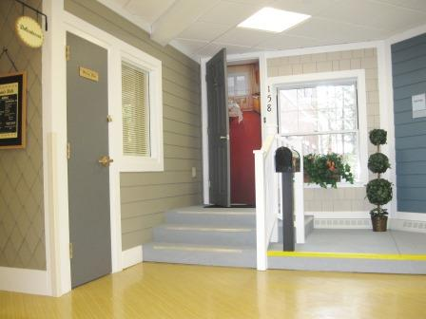
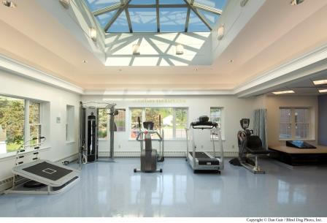
Rehabilitation at The Cedars…
State-of-the-Art Healing
820 Admissions
75% Community DC
Average LOS 15-21 Days

Slide 7
The Skilled Care Center: LTC…
Cherish your health
Stimulate your mind
Nurture our body
Cultivate your spirit

Slide 8
Drilling Down….
LTC:
56% Census
40.6% Dementia/Alzheimer’s Diagnosis
38% Behavior Symptoms
We Needed to Engage Residents with Behavioral Symptoms to Improve Clinical Outcomes

Slide 9
Our story begins…

Slide 10
It is The Cedars Belief….
Our values
Person-Centered Approach to Care
Choice
Dignity
Individuality: Sense of Self

Slide 11
Our Foundation….
Life stories
Spontaneous activities
Individual and Small Group
Scheduled activities
Large group
Use of volunteers
Educational Institutions

Slide 12
Clinical Outcomes…
Antipsychotics: National, Regional, State Averages…
National: 22.8%
Regional: 23%
State Averages: 19.8%
The Cedars
8.8%

Slide 13
Our Journey….

Slide 14
2015 Percent Falls…

Slide 15
Engagement of the Arts…
Visual
Music
Movement Based
Writing
Drawing
Painting
All Have Positive
Clinical Outcomes….

Slide 16
Supporting Resident Engagement Unique Programing…
Flower program
Very popular program
Performed weekly
Overseen by a florist
Supported by activities fund
Easy implementation
Individual, small and large group settings

Slide 17
Arts & Technology….
Music and Memory Program
Certification needed
24/7 program
Personalized music program using iShuffles
Evidenced based program
Easy to implement
Relatively low cost: depends profit /not-for-profit
http://musicandmemory.org/

Slide 18
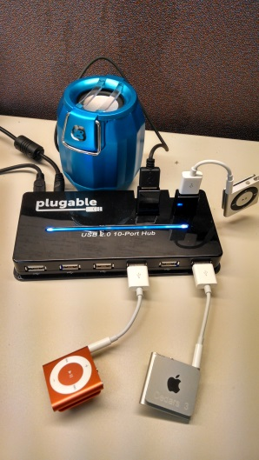
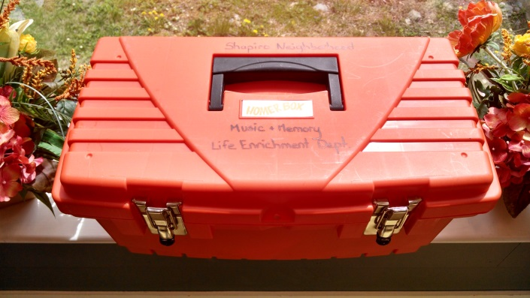
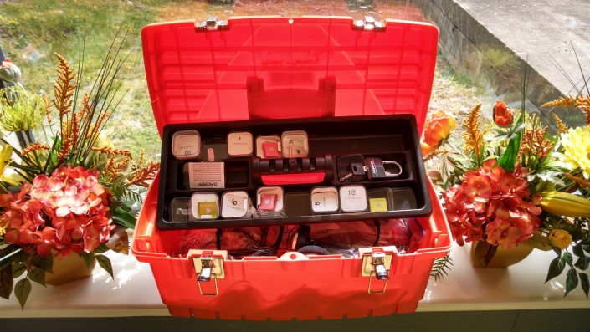
Equipment ….

Slide 19
Arts &Technology…
It’s Never 2 Late
Makes technology and the internet accessible to all
Adaptive hardware, software and content
Easy to implement
24/7 program
Cost: $2,500/yearly
Start-up cost: $10,000.00
Can be used by Rehabilitation Therapy Department
My page, social, cognitive, spiritual, physical
http://www.in2l.com/

Slide 20
It’s Never 2 Late…

Slide 21
The Arts…
Opening Minds through Art
Evidenced-based intergenerational program
Certification needed : $500.00
Visual art program: abstract art
Developed by Scripps Gerontology Center at Miami University, Ohio
Benefits: Expression, engagement, socialization
Cost: Instructor $1,200.00, supplies $2,000.00
Harder to implement
http://www.scrippsoma.org/

Slide 22
Opening Minds through Arts…

Slide 23
A Unique Partnership: University Support…
The Cedars will provide students a unique opportunity to spend time with other disciplines, preform a life history and medical record review, learn about geriatrics in an IL/AL/LTC setting, establish a relationship with an elder teacher and participate in The Cedars Opening Minds to the Arts program. The combination of classroom and experiential learning will provide the student with real life application and experience in the field of geriatrics. A three credit course.

Slide 24
Technology with the Arts…
Memory Lane TV
Multi-sensory & interactive film collection
Video, music, photography, recorded sounds and aromas
Stimulate recollection, enhances socialization
Easy to implementation
24/7 intervention
Requires some training
Cost: $180 memory stick, sent boxes $300.00, plus TV
? Monthly subscription
http://memory-lane.tv/

Slide 25
Memory Lane TV…

Slide 26
Resident Benefits: Improved Quality of Life…
Mood
Decrease anxiety, agitation, depressive statements
Alertness
Decreased somnolence
Increased eye contact, ability to attend to task
Engagement
Decreased restlessness
Singing, smiling
Socialization
Conversation
Reminiscence
Positive Redirection
Activity
Therapeutic exercise
Self-feeding
Diversion
Stable mood during increased activity in environment
Bereavement
Identity
Person-centeredness

Slide 27
Staff & Facility Benefits…
Staff
Supportive environment
Anticipating needs
More efficient
Strong relationships
Clinical
Quality of Care: Antipsychotics/Falls
Facility
Increase referrals
Increase retention
Better quality outcomes

Slide 28
Covering Costs…
Activities Fund
Art Show
Community Outreach Activities
High Schools; ishuffles
Fund Raising Activities
Auxiliary Support
Individual Interest
University Support

Slide 29
Contact….
Angela Hunt, PT,MS
Chief Operating Officer/Administrator
ahunt@thecedarsportland.org
Questions

